Slide 1
Penile Cancer

Slide 9
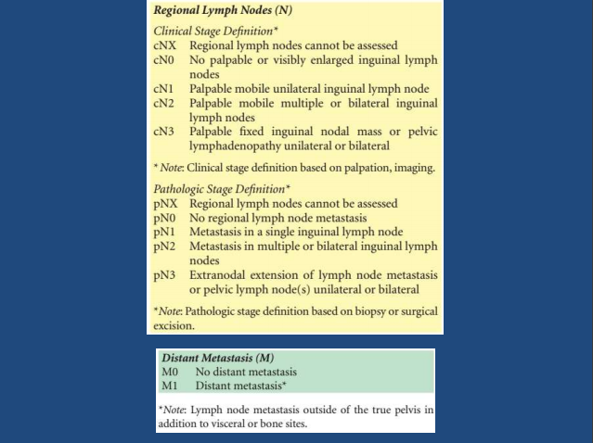

Slide 10
