Slide 1
CARCINOMA OF UNKNOWN PRIMARY

Slide 2
Carcinoma of Unknown Primary
Definition
Epidemiology
Pathology
Natural History
Diagnostic Approach
Treatment

Slide 3
Definition
A biopsy-proven metastatic cancer in the absence of radio graphically or pathologically detectable primary tumor after an “adequate” diagnostic evaluation.
No universal agreement over definition of what constitutes “adequate”

Slide 4
Epidemiology
Incidence :
  2 to 5% of all cancers
  One of the “top” ten cancers in the USA.
  ? 4th most common cause of cancer death
  Median age at presentation is 60 years.
  Slightly more prevalent in males
Life expectancy : very short , median survival : 6-9 months

Slide 5
CUP - Biology
Heterogeneous group of malignancies characterized by:
» Early dissemination in the absence of a detectable primary tumor
» Unpredictable metastatic pattern
» Aggressive biological and clinical behavior.
Hypotheses for tumors presenting as CUP:
  Primary tumor regresses after seeding the metastasis or remains so small that it is no longer detected.
  Primary may have been eliminated or contained by body’s defenses.

Slide 6
Clinical manifestations
Symptoms or signs related to local findings due to metastatic sites.
Constitutional symptoms : weight loss, fever
Physical exam :
  pleural effusions/ ascites
  adenopathy,
  hepatomegaly
  other abnormalities related to the involved sites.
Multiple sites of involvement observed in more than 50% of patients with occult primary tumors.
Common sites of involvement : liver, lungs, bones, and lymph nodes.
Certain patterns of metastases suggest possible primaries, occult primaries can metastasize to any site.
Should not rely on patterns of metastases to determine the primary site.
•

Slide 7
DIAGNOSTIC EVALUATION
The likelihood of determining the primary site depends upon
  histologic category
  the site of presentation.
The initial work-up of patients presenting with a presumed CUP should not be exhaustive, and should instead be geared toward evaluation of likely primary sites.
A precise diagnosis is desirable in since therapy for these tumors is quite different and may be potentially curative .

Slide 8
Clinico-Pathological Entities of CUP
Site of presentation | Histology
Liver (mainly) and/or other organs | Adenocarcinoma, Moderately/ poorly differentiated
Lymph nodes Mediastinal or RP (midline distribution) Axillary Cervical Inguinal | -Un or poorly differentiated CA Adenocarcinoma, Well to poorly differentiated Squamous Cell Carcinoma Undifferentiated Ca, SCC, Mixed SCC/ Adeno Ca
Peritoneal Cavity Peritoneal Adeno - carcinomatosis in females Malignant Ascites of other/unknown origin | Serous/ papillary adenocarcinoma (+/- Psammoma bodies) Mucinous adenoca – moderately/ poorly differentiated ( +/- signet ring cells)
Lungs Pulmonary metastases Pleural effusion | -Adeno Ca, various diff -Adeno Ca, poorly or mod diff
Bones – solitary / multiple | - Adeno Ca, various diff
Brain – solitary/ multiple | - Adeno Ca, various diff
Neuroendocrine Tumors | - Pdiff cancer with neuroendocrine features (mainly), low grade neuroendocrine ca, small cell anaplastic ca

Slide 9
“Adequate” Evaluation
Clinical and Laboratory data required to define a patient as having “CUP” :
  Histologically confirmed Metastatic cancer
  History and Physical Examination ( incl . Pelvic/ Rectal exam)
  Laboratory studies: CBC, CMP, Urinalysis, Stool occult blood
  Radiological studies :
» Chest X-RAY
» Ct SCAN – Chest/ Abdomen/ Pelvis
» PET/CT - ? Role
  Invasive Procedures:
» EGD, Bronchoscopy, Colonoscopy – Depending upon the pathology and clinical presentation of CUP
  Pathological Evaluation :
» Microscopic examination - Histology
» Immunohistochemistry

Slide 10
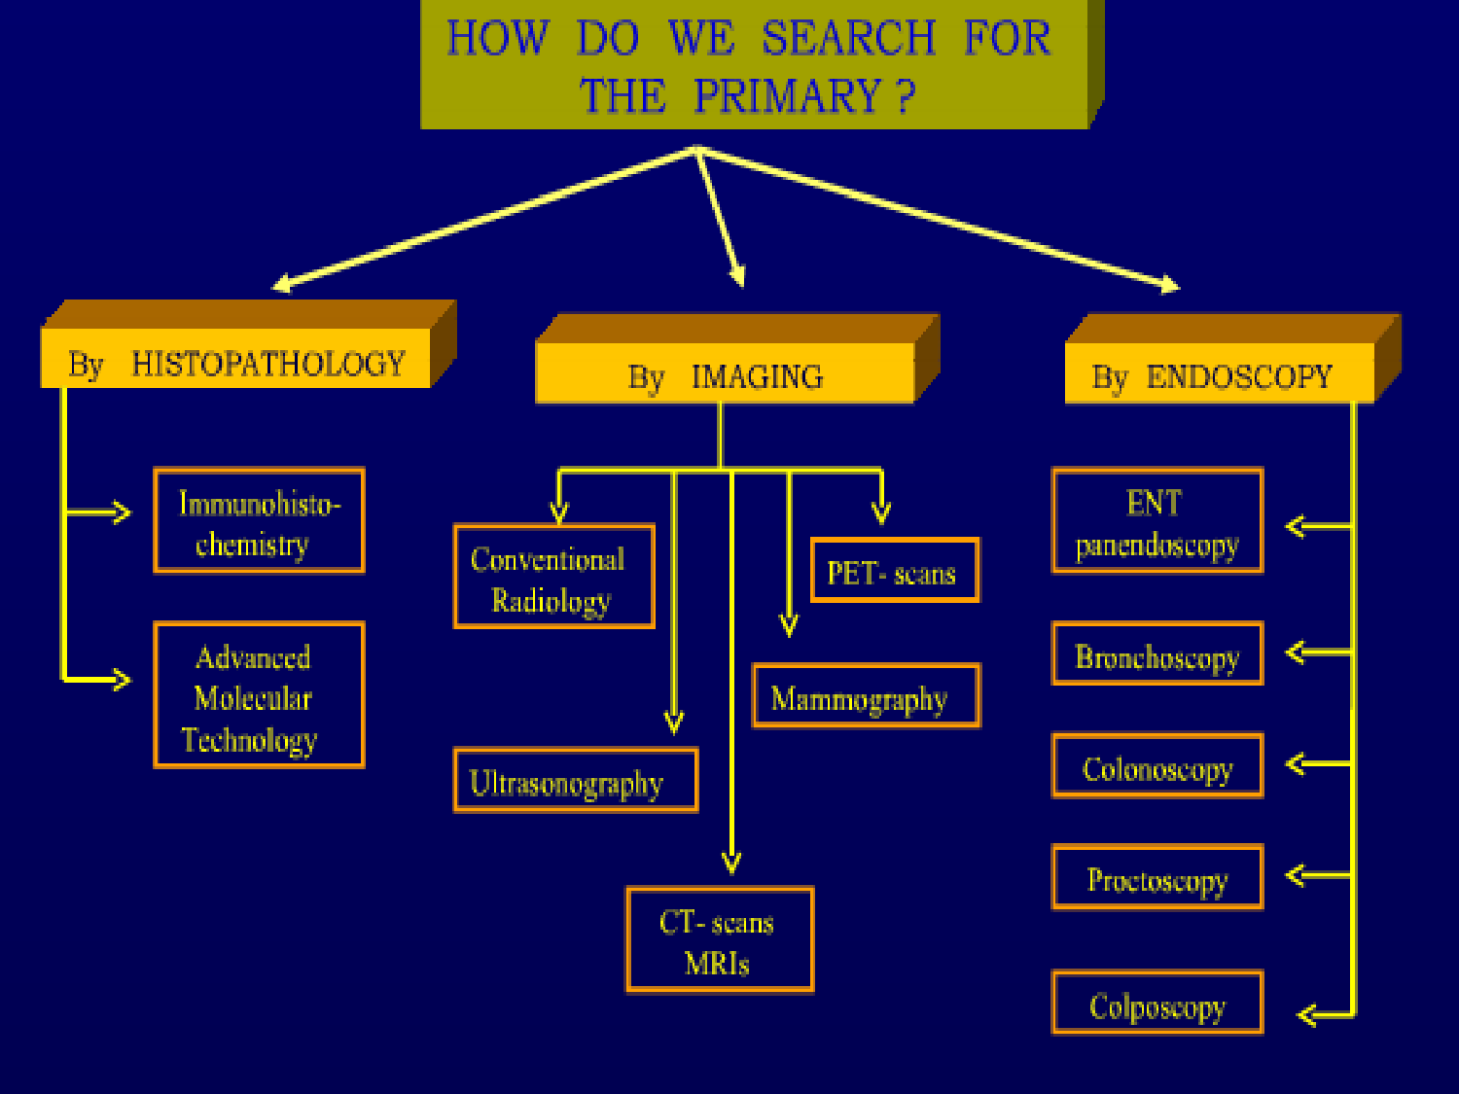

Slide 11
Pathology
Microscopic examination:
– Features of carcinoma seen on H and E slides.
Remember Sarcoma, Melanoma and Lymphoma may also show epithelial (carcinomatous) features sometimes.
60% adenocarcinomas, 5% squamous carcinomas, 35% (mixed)
– Once tumor is classified as a “Carcinoma” , other histo- pathological features can be used to suggest the site of origin : Examples:
–
–
» Comedo-necrosis ( breast cancer)
» Prominent Nucleoli ( prostate cancer)
» Pseudo-stratification – Good clue in GI cancers
» None of these features are 100% specific for the site of origin

Slide 12
Pathology
Major Histologies in CUP
Histology | Proportion %
Adenocarcinoma, well to moderately differentiated | 60%
Squamous Cell Carcinoma | 5%
Poorly differentiated carcinoma/ poorly differentiated Adeno ca | 30%
Neuroendocrine | 2%
Undifferentiated Malignancy | 3%

Slide 13
Adenocarcinoma
•
Diagnosis of adenocarcinoma - based on the identification of glandular structures that are formed by the neoplastic cells.
Poorly differentiated adenocarcinoma diagnosed when only minimal glandular formation is seen on histologic examination or in tumors that lack glandular differentiation but stain positively for mucin.
Adenocarcinoma, poorly differentiated adenocarcinoma, and poorly differentiated carcinoma are histologic diagnoses that represent a spectrum of tumor differentiation rather than specific well-demarcated entities

Slide 14
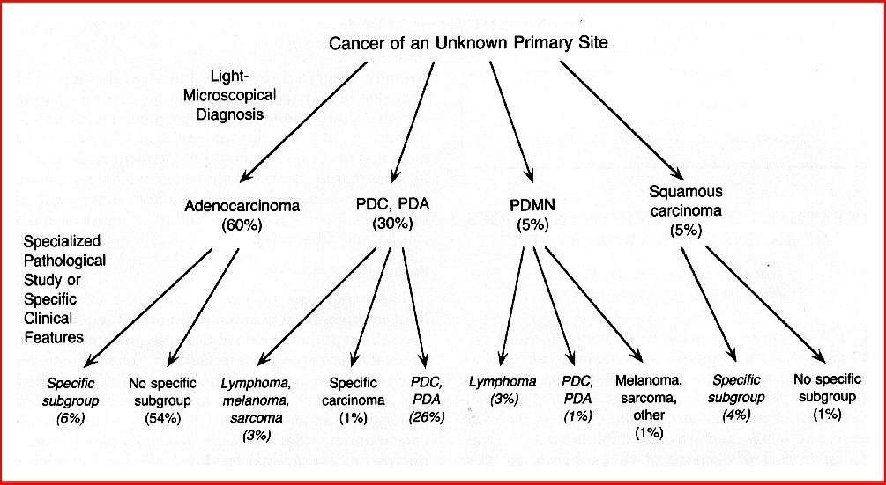

Slide 15
Pathology
Immunohistochemistry:
IHC stains: these are peroxidase labeled antibodies against specific tumor antigens that are used to define tumor lineage.
IHC stains should be used in conjunction with the patient’s clinical presentation and imaging studies to select the best therapy.

Slide 16
Pathology
Immunohistochemistry
Benefits:
  Very helpful in determining the site of origin for CUP
    Cytokeratin 7 / Cytokeratin 20 are the most helpful .
    Other stains: helpful in suggesting the possible site of origin
» TTF-1 – Lung, Thyroid
» GCDFP-15-Mammoglobin – Breast
» Calretinin – Mesothelioma
» URO III , Thrombomodulin – Urothelial carcinoma
» CDX-2 - GI Tract cancers
» Chromogranin, Synaptophysin – Neuroendocrine cancers.
» PSA (prostate cancer) and thyroglobulin (thyroid cancer) are the most specific of the current marker panel. However, the prostate and thyroid ca rarely present as CUP – so the yield of these markers is low.
» GCDFP-15 and uroplakin III are highly specific markers for breast and urothelial cancer respectively – but both are not verey sensitive for detecting these cancers
–
Remember : Poorly or undifferentiated tumors often show loss of one or all of these markers

Slide 17
Pathology
Immunohistochemistry
Caveats:
  Tissue specificity - No staining pattern is entirely specific
  Technical performance – can be variable between laboratory due to lack of standardization of antibodies, staining techniques and protocols used in IHC staining.
  Inter-observer variability : significant variability exists between pathologists based on their experience in interpreting IHC.
  Communication between treating physician and pathologist is extremely important.

Slide 18
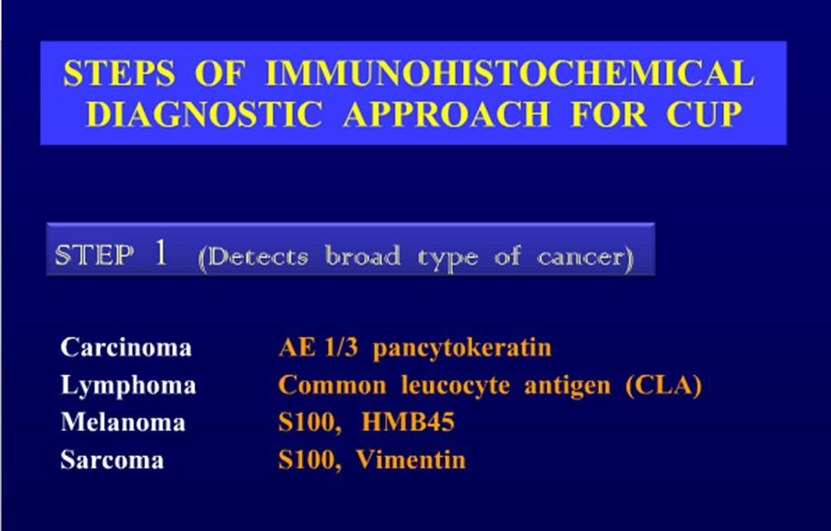
Pathology

Slide 19
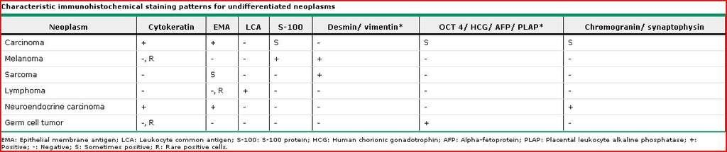

Slide 20
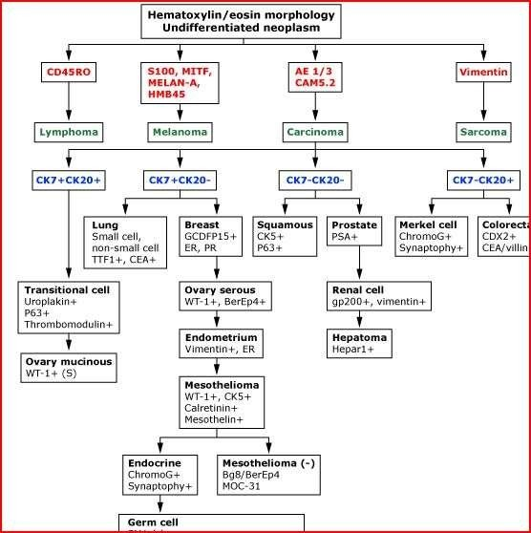
CUP - IHC
Once the broad category is identified as “carcinoma”, Cytokeratins are used to further to determine the possible site of origin.
Further specific markers are then used to try to pin-point the most likely site of origin

Slide 21
Immunohistochemistry
Cytokeratins (CKs)
20 sub-types of CK with different molecular weight and different expressions are seen in various cancers and cell types.
Monoclonal antibodies to specific CK sub-types are used classify tumors according to site of origin.
CK20/ CK7 are most useful and hence, most commonly used.
CK7 → seen in lung, breast, ovary and endometrium
NOT seen in lower GI tract
CK20 → seen in GI epithelium, urothelium and Merkel’s cells.
A pattern of CK20+/CK7- strongly suggests GI neoplasm
A pattern of CK20-/CK7+ suggests cancer of lung, breast, ovary, endometrium and pancreatic biliary tract.

Slide 22
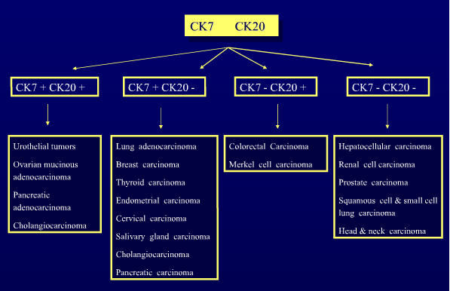
Immunohistochemistry - Cytokeratins (CKs)

Slide 23
Immunohistochemistry
Other Markers
CDX-2 – a nuclear transcription factor that plays a role in intestinal organogenesis. If positive , favors Gastrointestinal adenocarcinomas.
TTF-1 – thyroid transcription factor-1 – nuclear protein that helps in transcriptional activation during embryogenesis in thyroid, diencephalon and respiratory epithelium.
»
»
Typically, positive in Lung and Thyroid cancers
In lung carcinoma, 68% of adenocarcinomas and 25% of squamous cell cancers stain +ve for TTF -1
Hence, helpful in differentiation of lung primary from metastatic adenocarcinoma in pleural effusion, mediastinum and lung parenchyma
»
Calretinin & Wilm’s tumor gene-1 are useful markers for mesothelioma ( distinguishing pleural mesothelioma from lung adenocarcinoma can be
very challenging).

Slide 24
Immunohistochemistry
Other Markers
Tissue Marker | Diagnosis
TTF-1 | Lung, Thyroid
CDX-2 | GI tract
Gross Cystic Disease Fibrous Protein 15 (GCDFP) | Breast
ER, PR | Breast
BRST1 | Breast
Thyroglobulin | Thyroid cancer
PSA | Prostate cancer
Calretinin, Mesothelin | Mesothelioma
Chromogranin, Synaptophysin, Neuron specific enolase | Neuroendocrine cancer
URO III, thrombomodulin | Urothelial Ca/ Bladder Ca
Beta-HCG | Germ cell tumor
Alpha-Feto-protein | HCC, germ cell tumor
S-100, HMB 45 | Melanoma
Leucocyte common antigen | Lymphoma

Slide 25
Imaging
CUP

Slide 26
Imaging Studies in CUP
Imaging | Diagnostic Value
Chest X-Ray | Pre-Requisite test
CT chest/ abdomen/ pelvis | 40% accuracy/ guidance to biopsy
Mammogram | Low sensitivity
MRI ( breast) | 60% accuracy
Barium Studies | Not Useful
PET/CT scan | Useful in certain situations

Slide 27
Role of PET-CT in CUP
Questions remain regarding the Role of PET/CT.
Routine use not recommended
Good candidates for PET/CT
  CUP Patients with cervical adenopathy/ squamous cell neck LAD
  Patients with single metastatic focus – prior to definitive loco- regional therapy.
In patients with disseminated disease, some evidence exists that PET/CT may be helpful in detection of primary in 20% cases.
» These studies were small and retrospective
» Cost effectiveness not clear
» Additional sites of metastases may be detected more often than the primary

Slide 28
Endoscopy
CUP

Slide 29
Endoscopy in CUP
Only perform endoscopic procedures oriented to clinical symptoms or signs!
Procedure | Indication in CUP
ENT – Pan-endoscopy | Cervical Node involvement
Bronchoscopy | Symptoms or radiographic indications
Colonoscopy | Relevant symptoms and signs
Proctoscopy | Inguinal node involvement

Slide 30
Serum Tumor Markers
Routine evaluation of current commonly used markers have not been proven of any prognostic or diagnostic assistance.
A non-specific multiple overexpression of adenocarcinoma markers (CEA, CA-125, CA19-9, CA-15-3) has been observed in majority of CUP patients.
Worthwhile to request:
Tumor Marker | Indication
PSA | In men with bone metastatic adenocarcinoma
B-HCG & AFP | In men with undifferentiated tumor
AFP | Patients with hepatic tumors
CA 125 | Women with papillary adenocarcinoma of peritoneal cavity

Slide 31
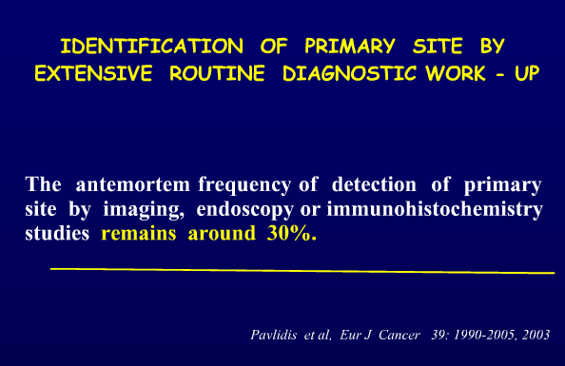
How often can the Primary be Identified?

Slide 32
Molecular Analysis
Developing therapeutic strategies for CUP is challenging in the absence of a known primary.
Current diagnostic yield of primary with imaging, endoscopy and IHC is 20 to 30%.
Use of gene expression studies aims to substantially increase this yield – up to 80% accuracy. So, instead of Empiric Chemotherapy – site specific chemotherapy can be used if the primary origin is identified by gene profiling.
RT-PCR or DNA micro-array techniques are commonly used to generate gene expression profiles.
•
Prospective validation trials are evaluating the role of molecular studies in

Slide 33



Slide 34
CUP - Treatment
Median survival in disseminated CUP is 6-12 months.
Systemic chemotherapy is main treatment modality in most cases. However, integration of surgery and Radiation and even periods of observation are very important in overall management of this condition.
Once the diagnosis is made, the next step is Identification of responsive (favorable) subsets for which specific treatment options exist.

Slide 35
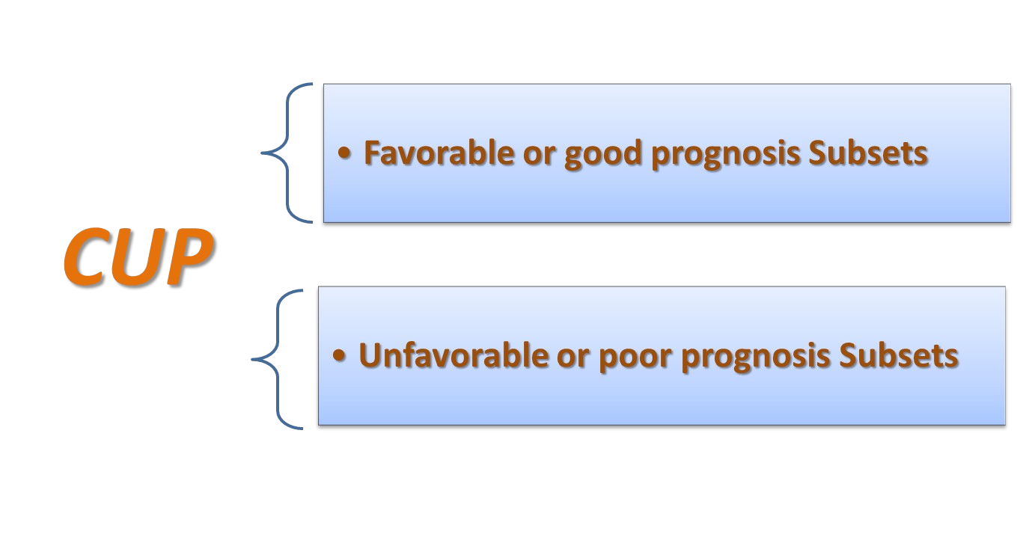

Slide 36


Slide 37
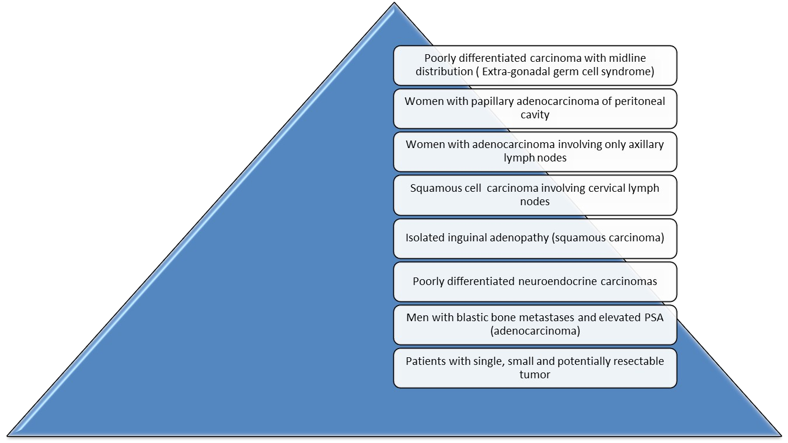
Favorable prognostic factors

Slide 38
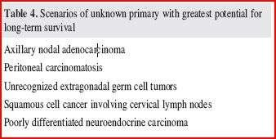

Slide 39
Poorly differentiated carcinoma with midline distribution ( Extra-gonadal germ cell syndrome)
Favorable subset

Slide 40
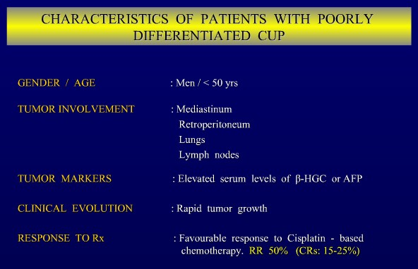

Slide 41
Women with papillary adenocarcinoma of peritoneal cavity
(Peritoneal adeno-carcinomatosis/ papillary)
Favorable subset

Slide 42
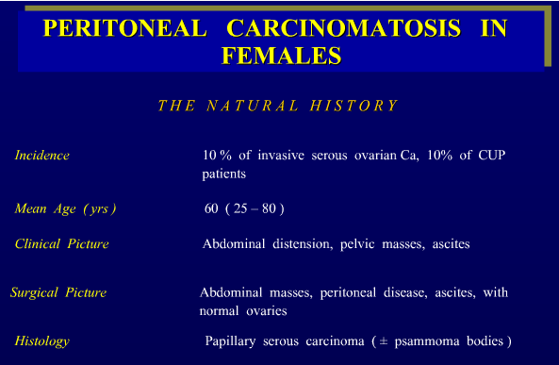

Slide 43
Women with papillary serous adenocarcinoma of the
.
peritoneal cavity
Characteristics:
  Remember the germinal epithelium of the ovary and peritoneal mesothelium share the same embryological origin. The site of origin cannot be identified even after abdominal exploration.
  Metastases have the histologic features of ovarian adenocarcinoma.
  Syndrome been termed peritoneal papillary serous carcinoma or multifocal extra-ovarian serous carcinoma.
  More common in women with BRCA-1 mutation and may also be seen after prophylactic oophorectomy .
  Elevated CA-125
  Favorable Sub-set
Treat as stage III ovarian cancer.

Slide 44
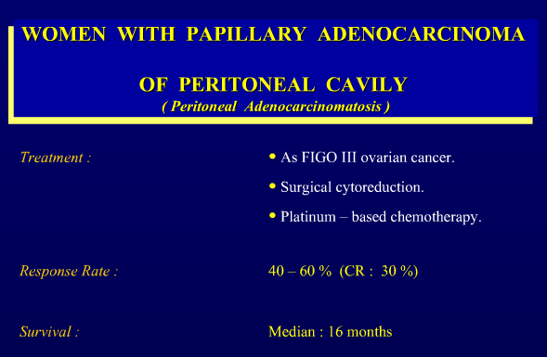

Slide 45
Isolated Axillary Nodal Adeno-carcinoma in women
Favorable subset

Slide 46
Women with isolated axillary adenopathy
Breast cancer should be suspected in women who have AUP (adenocarcinoma
of unknown primary) and axillary lymphadenopathy.
Lymph nodes should be tested for ER, PR, and HER-2/neu .
Evaluation : includes
  Physical examination of both breasts
  Mammography is indicated to search for a primary site.
  Bilateral breast MRI is indicated if mammography is negative
Clinically occult breast cancer will be found in approximately one-third of cases.
Modified radical mastectomy recommended, even when the results of physical examination and mammography are normal. Treatment options for ipsilateral breast include mastectomy or whole breast radiation therapy
Axillary node dissection recommended.

Slide 47
Women with isolated axillary adenopathy
Prognosis is similar to lymph node positive breast cancer.
  Mobile lymph nodes (N1) - Treat as stage IIA breast cancer.
  Fixed lymph nodes (N2) - Treated as stage IIIA breast cancer.
Treatment decisions:
  MRM + ALND → chemotherapy ± hormonal therapy/RT.
  Neoadjuvant chemotheray for N2 disease .

Slide 48
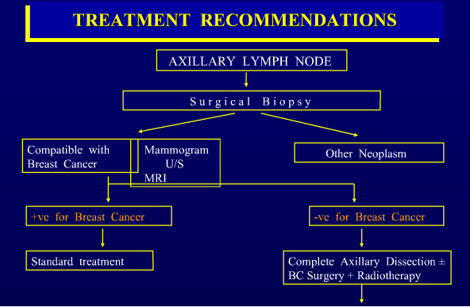
Chemotherapy followed by hormone therapy where indicated

Slide 49
Squamous cell carcinoma involving cervical lymph nodes
Favorable Subset

Slide 50
Squamous cell carcinoma of the cervical lymph nodes
Cervical lymph nodes - most common metastatic site for SCC of unknown primary.
A primary tumor in head and neck region should be suspected. Primary site not found in the majority of patients despite aggressive diagnostic approach.
Patients usually middle-aged or elderly.
History of substantial tobacco and/or alcohol use.

Slide 51
Squamous cell carcinoma of the cervical lymph nodes
Diagnostic evaluation:
Thorough examination of the oropharynx, hypopharynx, nasopharynx, larynx, and upper esophagus by direct vision
Fiberoptic nasopharyngolaryngoscopy, with biopsy of any suspicious areas.
Routine bronchoscopy not indicated if the patient has no pulmonary symptoms and if the chest CT is negative.
CT neck
PET/CT
HPV
EBV

Slide 52
Squamous cell carcinoma of the cervical lymph nodes
Initial tissue diagnosis is usually by FNAB ( fine needle aspiration biopsy)
Ipsilateral
Incisional biopsy of cervical node avoided
– In some studies, incisional biopsy associated with higher incidence of loco-regional failure and inferior survival after definitive treatment.
Treatment:
  Rx as locally advanced head and neck cancer
  Low stage (N1) – Surgery + RT or RT alone
  High stage (N2-N3) – Concurrent Chemoradiotherapy.

Slide 53
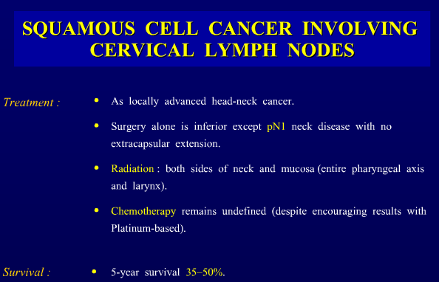

Slide 54
Squamous cell carcinoma of the cervical lymph nodes
Lower cervical or supraclavicular nodes
A primary lung cancer should be suspected.
Chest x-ray, head and neck examination. If these are unrevealing, proceed with Fiberoptic bronchoscopy.
If the fiberoptic bronchoscopy reveals a primary bronchogenic cancer
-→ positive cervical or supraclavicular lymphnode suggest metastatic lung cancer . Rx as metastatic lung cancer
Patients with no detectable disease below the clavicle : Rx with the same approach as patients with upper cervical nodes.

Slide 55
Neuroendocrine Carcinoma of Unknown Primary
Favorable Subset

Slide 56
Poorly Differentiated Neuroendocrine Carcinoma
IHC +ve for Chromogranin/ Synaptophysin/ NSE
Diffuse metastases to liver and bones is a frequent presentation
Platinum-based chemotherapy (platinum + etoposide).
  Response rate : 50 to 70% ( CR 25%)
  Median survival : 14.5 months

Slide 57
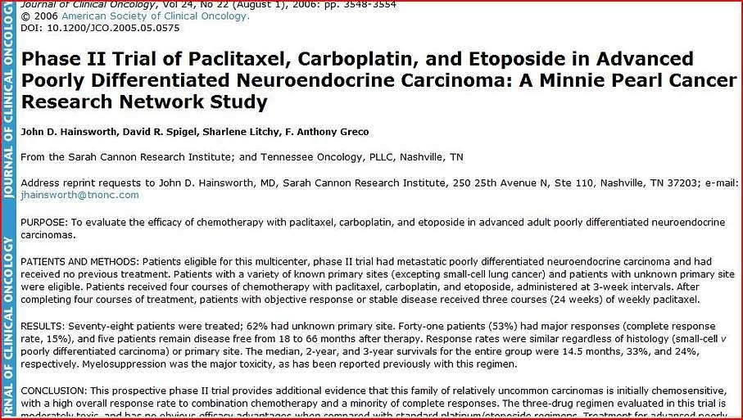

Slide 58
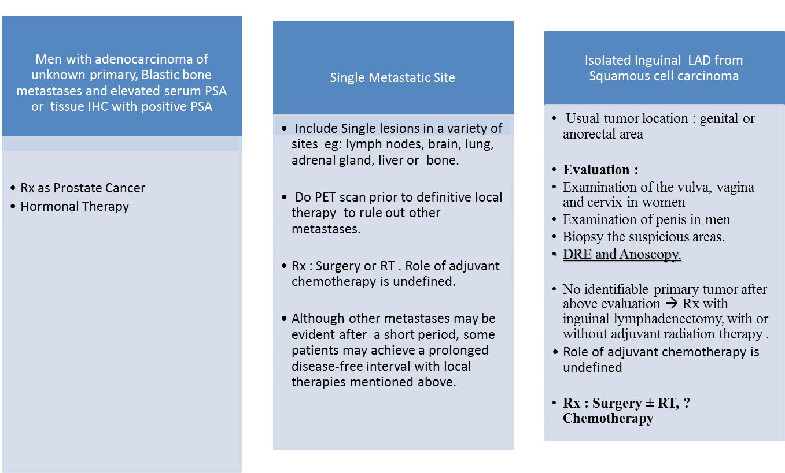
Other Favorable Subsets

Slide 59


Slide 60
Unfavorable features
Adenocarcinoma metastatic to the liver or other organs (multiple mets).
Non-papillary malignant ascites (adenocarcinoma)
Multiple cerebral metastases (adenocarcinoma or squamous cell carcinoma)
Multiple lung/pleural Metastases ( adenocarcinoma)
Multiple metastatic bone disease ( adenocarcinoma)

Slide 61
Adenocarcinoma of unknown origin (AUP)
The incidence of AUP increases with age.
Clinical presentation depends on sites of tumor involvement (frequently multiple) - often include the liver, lungs, lymph nodes, and bones.
Evaluation :
  PSA in all men
  Mammogram in women if breast cancer is a possibility. Breast MRI in the setting of a negative mammogram in women with adenocarcinoma involving the axillary lymph nodes.

Slide 62
AUP with a colon cancer profile
•
Predominant metastatic sites in the liver and/or peritoneum
•
Adenocarcinoma with histology typical of gastrointestinal origin
Typical immunohistochemical staining pattern including CK20-positive/CK7-negative, and CDX-2 positive.
Respond well to chemotherapy with FOLFOX plus Bevacizumab.

Slide 63
Patients with AUP do not fit into any of the clinical subgroups
•
Empiric chemotherapy may be considered.
5-fluorouracil- and doxorubicin-based regimens were used in past but produced low response rates ( 20 %) and very few CRs. So, no longer preferred.
Taxane and platinum containing regimens preferred
Improved survival and CR rates when compared to earlier regimens.
Paclitaxel and Carboplatin:
•
Choice for first-line therapy, based on the relatively large experience with this combination in AUP.
Addition of a third drug (either Etoposide or Gemcitabine)to a taxane and platinum regimen may improve efficacy.

Slide 64
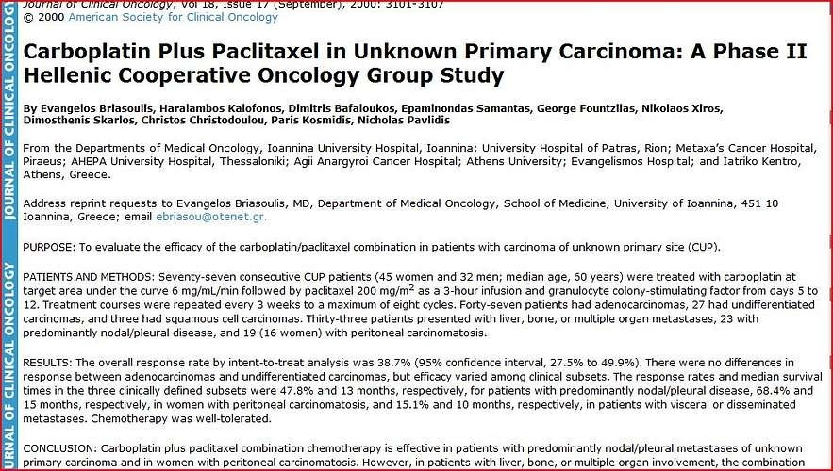

Slide 65
Newer regimens containing paclitaxel and gemcitabine have shown efficacy in phase II studies in the treatment of occult primary tumors.
Combination of carboplatin, gemcitabine and capecitabine was active in occult primary tumors with liver metastases in patients with good performance status.
Median progression-free survival (PFS) was 6.2 months; 1 and 2 year survival rates were 35.6% and 14.2% respectively.
•
In a recent multicenter phase II study, the combination paclitaxel and
carboplatin with bevacizumab and erlotinib was active and well tolerated as first-line therapy in patients with CUP.
The choice of the regimen should be based on the histologic type of cancer.

Slide 66
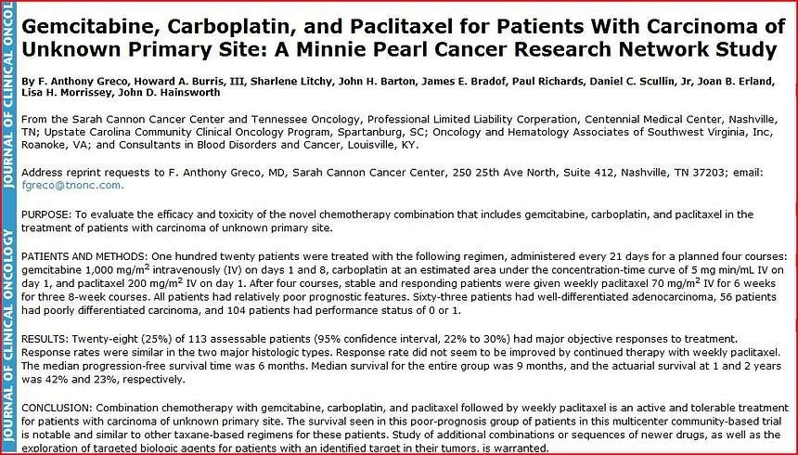

Slide 67
•
The following regimens are included in the guidelines for the treatment of adenocarcinoma of unknown primary, based on the results of the phase II studies
Paclitaxel and carboplatin with or without etoposide
Docetaxel and carboplatin
Gemcitabine and cisplatin
Gemcitabine and docetaxel

Slide 68
Second line therapy. Single agent Gemcitabine (1000 mg/m2 weekly three of four weeks) has modest activity.
The combination of Gemcitabine and Irinotecan has modest activity in recurrent or refractory carcinoma.(Phase II study in forty patients Cancer 2005 Nov 1;104(9):1992-7. ).
Phase II trial of bevacizumab and erlotinib in carcinomas of unknown primary site: the Minnie Pearl Cancer Research Network(J Clin Oncol. 2007 May 1;25(13):1747-52.)
  Patients with CUP who either had received previous chemotherapy or were previously untreated with poor-prognosis clinical features were eligible for this study.
  The median survival is superior to survival previously reported with second-line chemotherapy, and is similar to the results of many first-line chemotherapy trials.

Slide 69
Predictors of Response to empiric Chemotherapy - AUP
Features associated with a favorable response to treatment with empiric chemotherapy
  Tumor location in lymph nodes or soft tissue; in comparison, patients with involvement of the liver or bones have relatively poor prognosis
  Fewer sites of metastatic disease
  Female sex
  Poorly differentiated carcinoma histology
  Good performance status
  Normal serum lactate dehydrogenase (LDH) level
  Normal serum albumin
  Normal lymphocyte count .

Slide 70
Poorly differentiated neoplasm
The term poorly differentiated neoplasm is used when the pathologist cannot distinguish between carcinoma and other cancers, such as lymphoma, melanoma, or sarcoma.
Non-Hodgkin lymphomas, which are often curable with combination chemotherapy, account for 34 to 66 percent of the poorly differentiated neoplasms of unknown primary site.
remaining cases consist of poorly differentiated carcinomas; other tumors, including melanoma and sarcoma, collectively account for less than 15 percent of cases.
These tumors can be identified in many cases by immunohistochemical staining, electron microscopy, and/or cytogenetic analysis.
•

Slide 71
Follow-Up – CUP after Treatment
Follow-up consists of a history and physical every 3-6 months for the first 3 years and as clinically indicated thereafter.
Diagnostics tests should be performed for symptomatic patients.
•
•

Slide 72
Conclusion
CUP represents a group of heterogeneous tumors sharing the unique characteristic of metastatic disease without identifiable origin at the time of initial therapy
Although identification of the primary tumor may provide valuable information regarding both treatment and prognosis, aggressive diagnostic workup is usually of little value and not cost effective
The recommended approach is to pursue a limited diagnostic approach to identify favorable subsets.

Slide 73
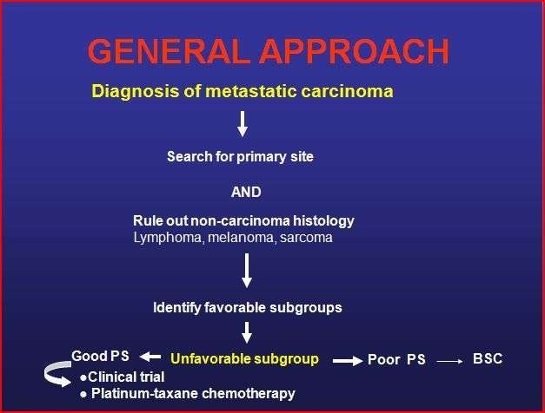

Slide 74


